Slide 1

Big Data Analysis System
Tianyu Tan, Wen Gu

Slide 2
Feature
All in one management
Periodically triggered

Slide 3
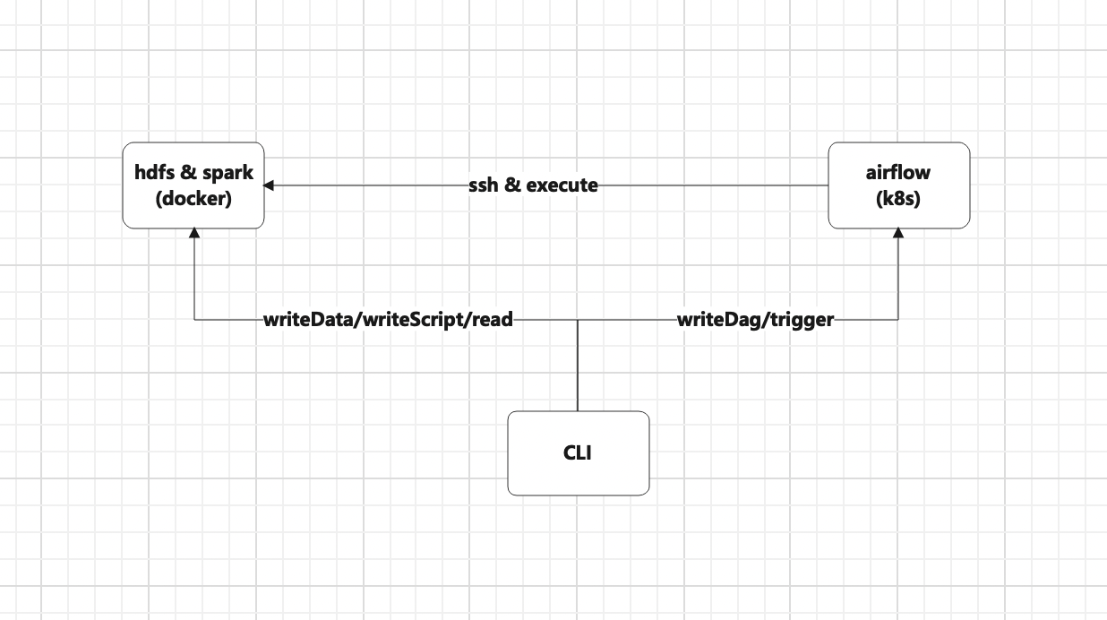
Architecture

Slide 4
Architecture
CLI unit provides a all-in-one station to manipulate all the files the analysis pipeline requires.
HDFS&Spark unit is where the analysis happens.
Airflow unit enables the analysis to be periodically triggered, which results in an always-up-to-date result. It also provides data-orchestration ability, which will be very useful if we want to split our analysis task into several subtasks.

Slide 5
Commands
writeData: Write .csv files to a fixed HDFS directory where spark tasks read from.
writeScript: Write pyspark files to a fixed HDFS directory where airflow taskRuns read from.
read: Read analysis result from a fixed HDFS directory where spark analysis stores its result to.
writeDag: Copy airflow dag to a fixed local directory and use github to synchronize it to airflow webserver pod, scheduler pod and worker pod.
trigger: Trigger a new data analysis task and update the analysis result.

Slide 6
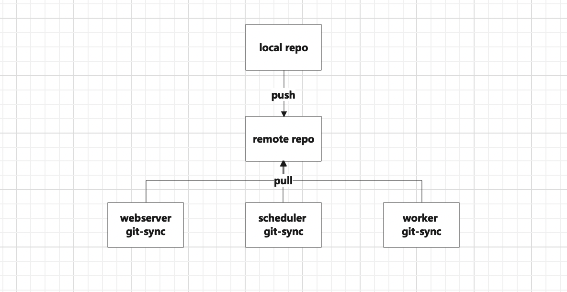
Technical points
Reflection to avoid handling user input case by case.
Local resolving to access HDFS datanode which is in an internal network on GCP
Git-sync to synchronize dags to kubernetes pods

Slide 7
Challenge
Editing airflow image doesn’t help installing JDK and defining environment variables in the pods, which restricts the usage of a SparkSubmitOperator. So I have to update the rsa public key every time I change the airflow worker
CSV files have different headers(both in categories and sequence). To make the analysis executed in a correct manner, I can’t union the files all at once, but have to format the data row by row, which slows the analysis process down 10x.

Slide 8
Experimental tasks

Slide 9
Dataset
The experimental task is based on the LE dataset
Destination
After observation and discussion, we narrow down the relevant attributes and focus on studying the following two relationships -- The relationship between temperature and battery health reduction rate, and the relationship between m_vs and battery health reduction rate.
Algorithm
The core algorithm is simple, go through the whole dataset, compute the battery capacity with battery_state_of_charge_pct and battery_available_energy_wh, then divide delta battery capacities by delta time. The result should be the battery health reduction rate.
Our result is to group the battery health reduction rates by either m_vs or temperature, then take the average.

Slide 10
Outcomes
Unfortunately, for now we haven’t found any meaningful relationship between m_vs/temperature and battery health reduction rate.
Our assumption was that as m_vs/temperature goes up, the battery health reduction rate goes up as well, which is intuitive as well. However, the data fluctuates and sometimes even shows that battery health reduction rate is negative(which means the battery has larger capacity than at previous timestamp).
It’s hard for us to explain this phenomenon, probably there are other unknown factors that are relevant but not included in the research. Or we might need a data scientist to design a more practical analysis process.

Slide 11
Thank you! :)

